Slide 1
ARCTIC Summer Camp 2023
July 17 - July 21, 2023, 9 a.m. - 5 p.m.
GSU Library North, Classroom 1

Slide 2
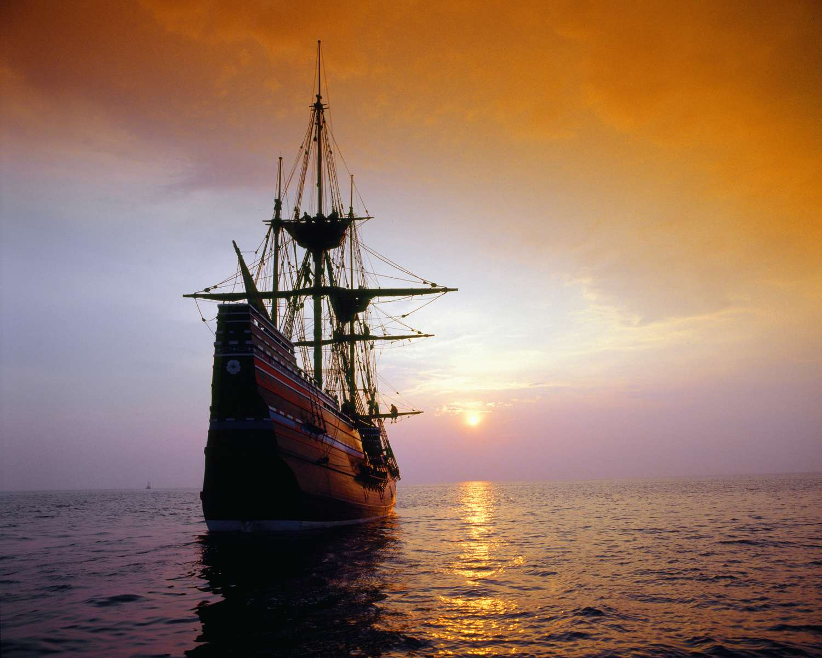





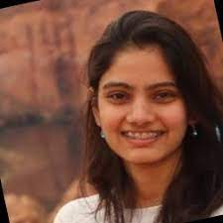

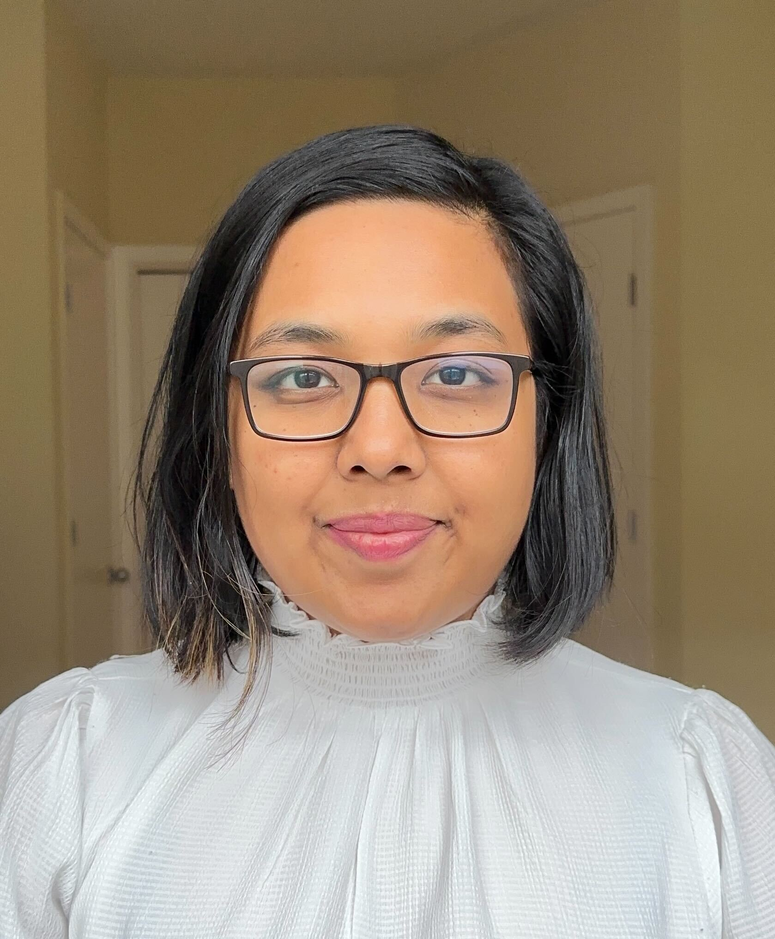


Jamie Thaubald
The Crew

Slide 3
Logistic
Always check in at the library entrance.
GSU library is a restricted area, if you are NOT a GSU student do not wander around in the library. Come directly to the classroom.
Light breakfast Coffee/tee will be provided in the room.
Lunch will be provided at Panther Dining hall at Piedmont Central.
Please check with us if you drive to the campus. We may arrange free parking for you. (non GSU students)

Slide 4
Connecting to GSU network
Select GSU-Guest Wireless account
Use provided credentials
Once you connect to GSU network, please try to log in to https://hemera.rs.gsu.edu/
Use the credential provided.
You will need to setup two factor authentication with duo.
Please follow this documentation https://technology.gsu.edu/technology-services/cybersecurity/duo-multifactor-authentication/

Slide 5
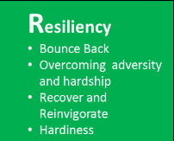
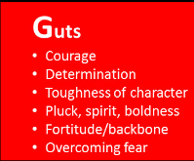
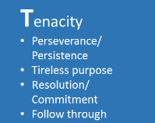
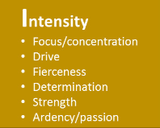
What tools you will need
G.R.I.T
Math
Programming
Computer Architecture
Electronics
Physics
Information Technology

Slide 6
What you will learn
You will learn how to configure hardware chip (Microcontrollers ) using software
Microcontrollers are everywhere, you interact with them everyday,
vehicles, robots, office machines, medical devices, mobile radio transceivers,
vending machines, home appliances, smart switches are some examples.
Establish communication between different hardware components
Gather data from devices
Analyze data and derive conclusions
Make data driven decisions and control hardware
* all most all images are from Intrnet, and ownership belongs to respective content creator

Slide 7
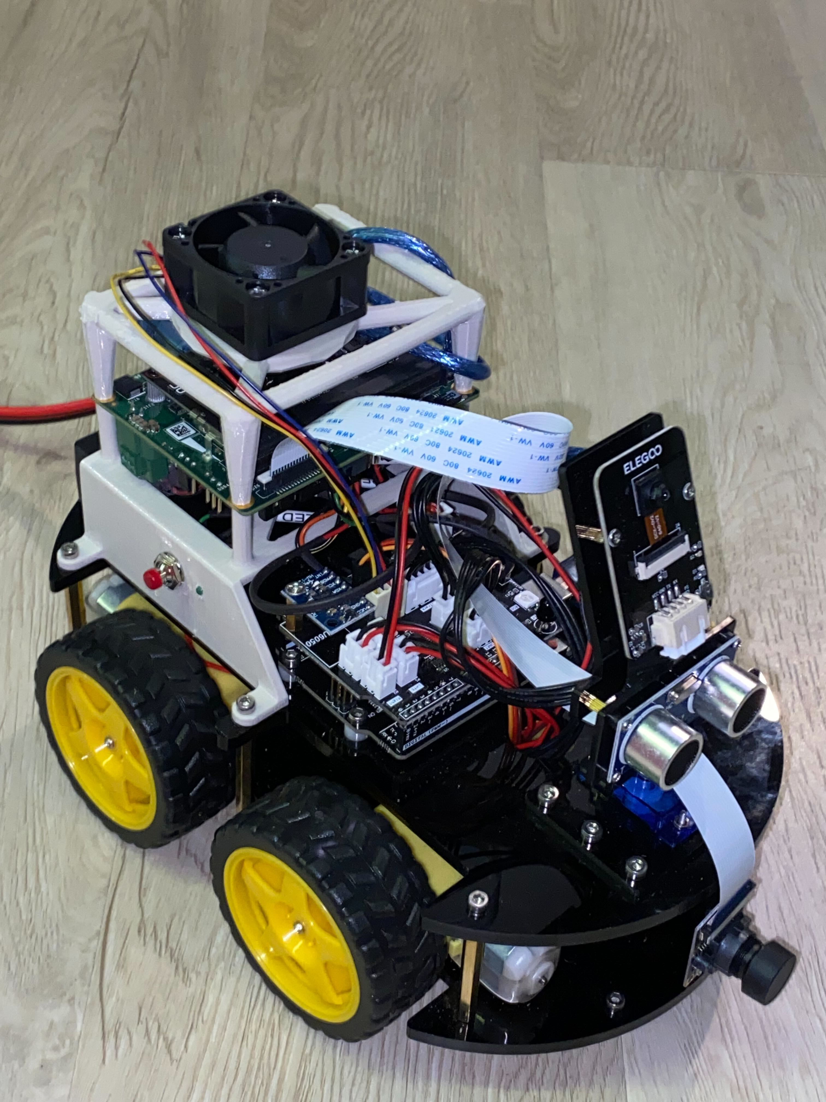
What we will do during the workshop
We will build a self driving car
We will learn
How to interact with outside world through sensors
Read the sensor data and process/analyze them to derive insights
Use mathematics and apply physics principles to navigate physical world
Control electronic (actuators) correctly to achieve desired outcome

Slide 8
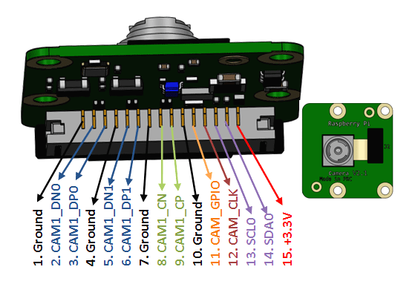
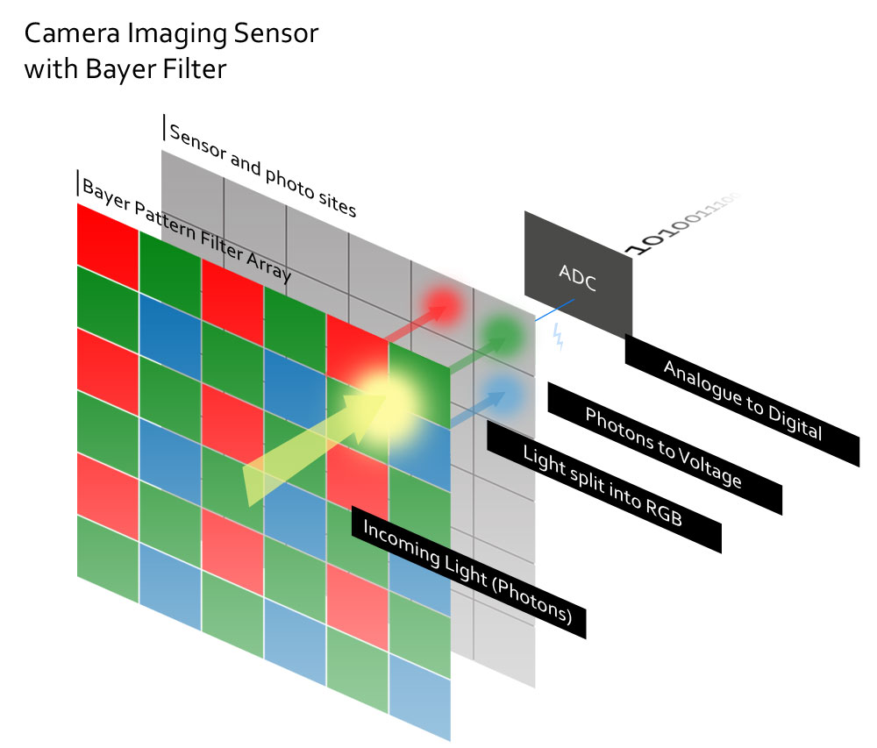
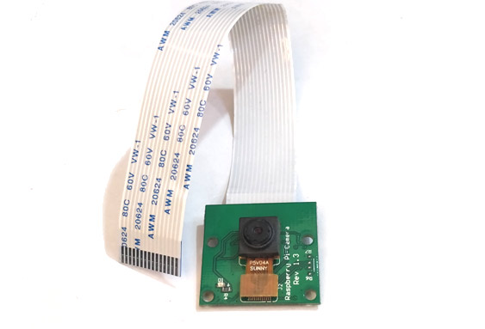
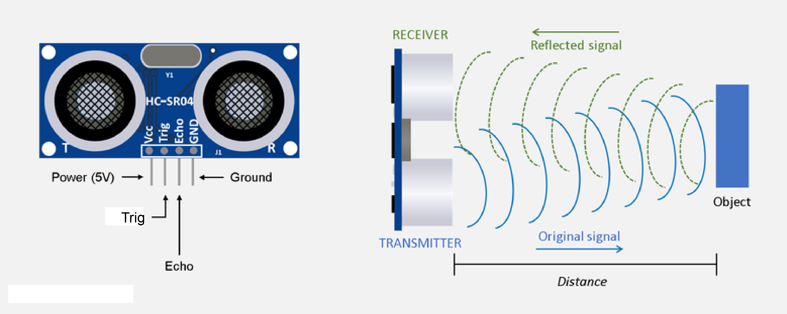
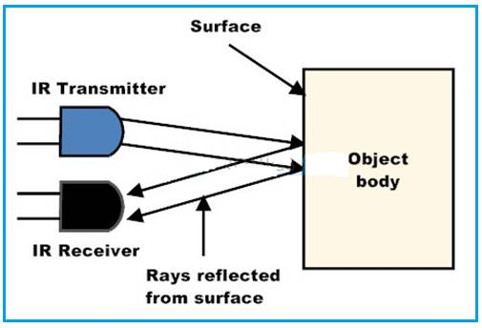
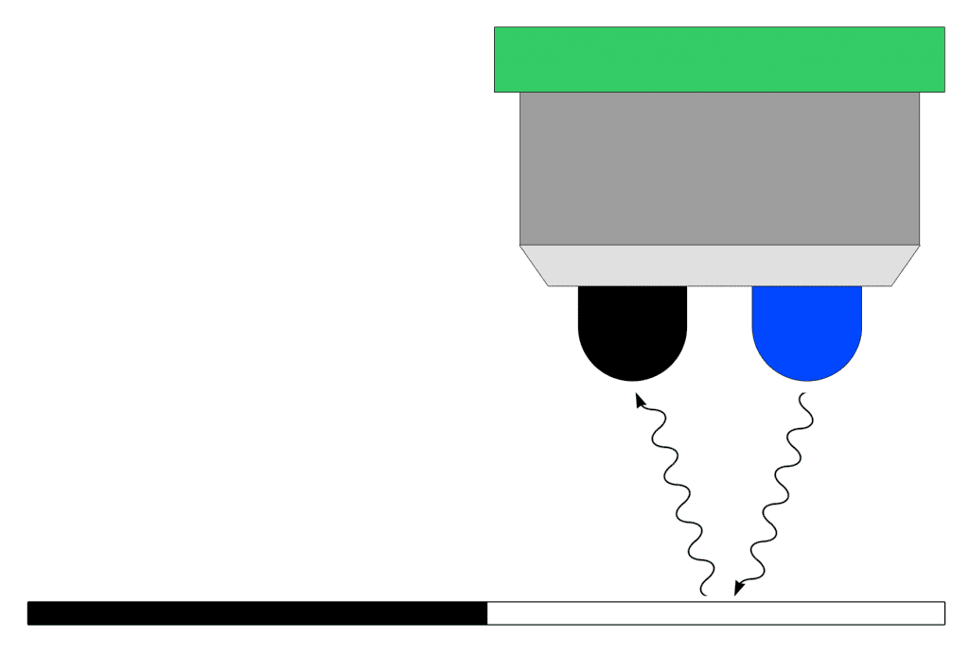
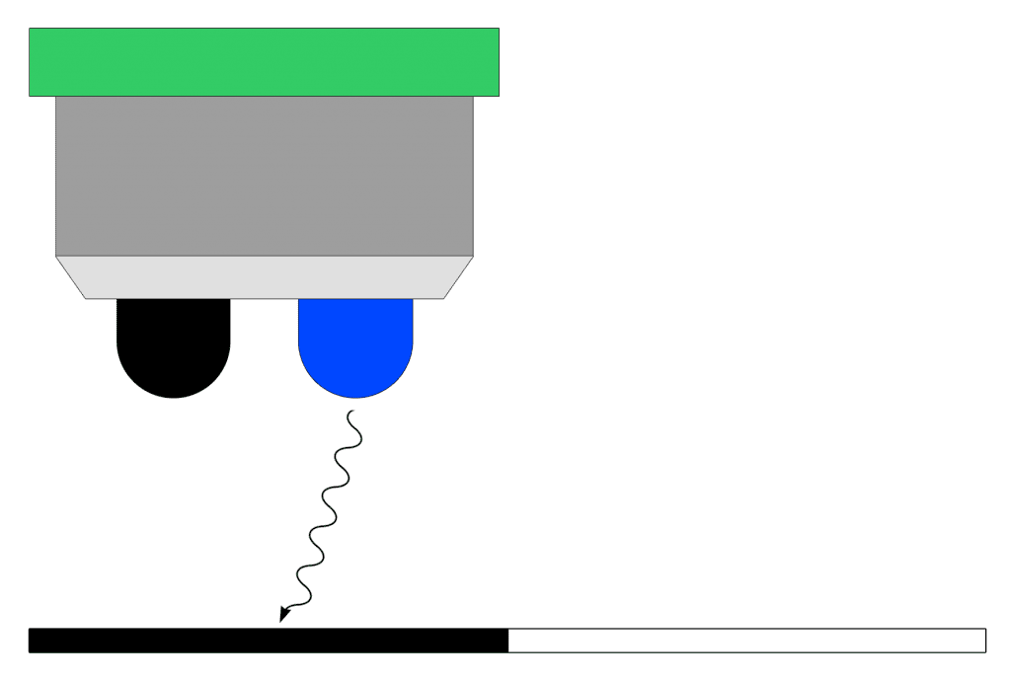
Interact with outside world
Camera – Video
Ultrasound - Distance
Infrared – Thermal

Slide 9
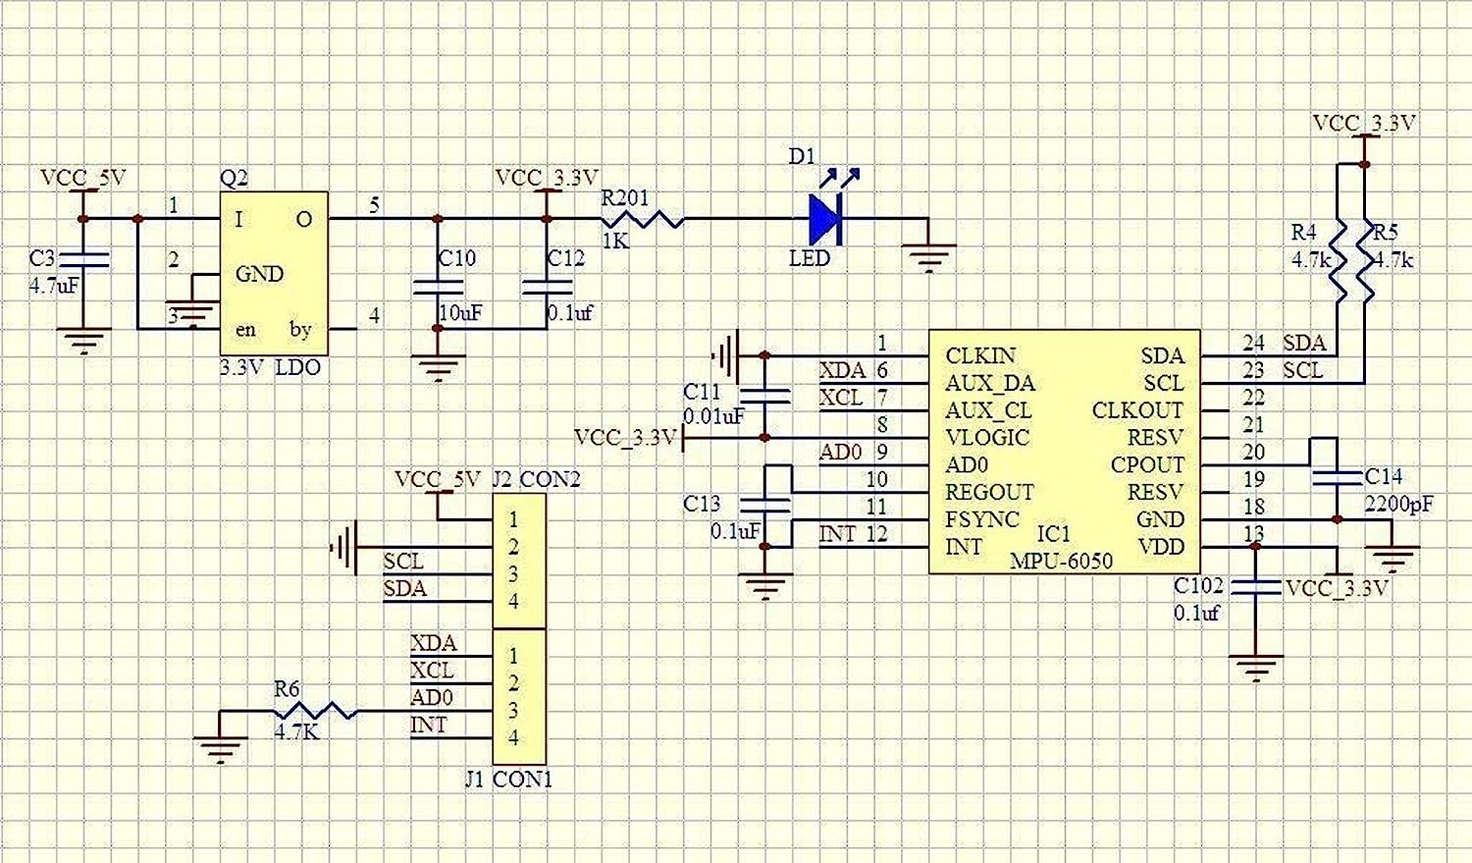
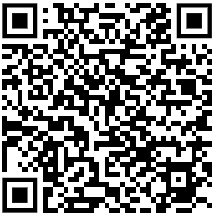
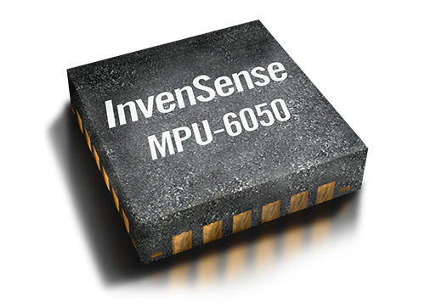
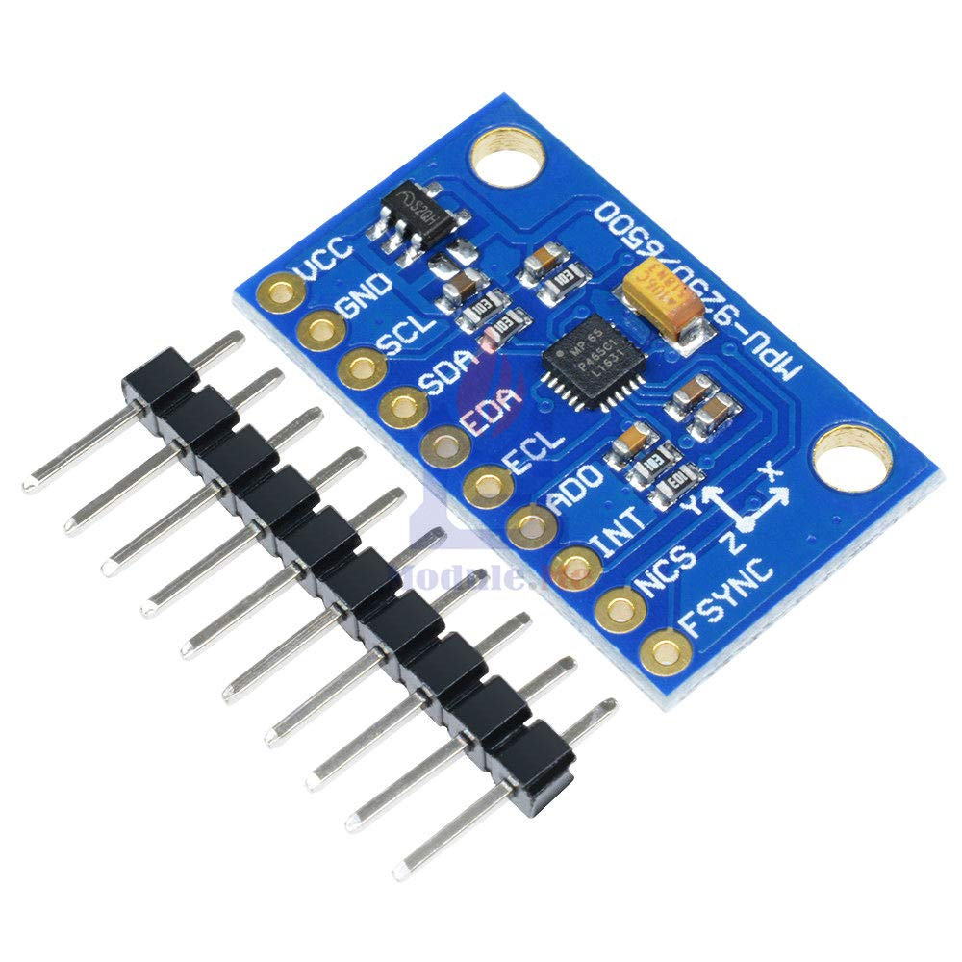
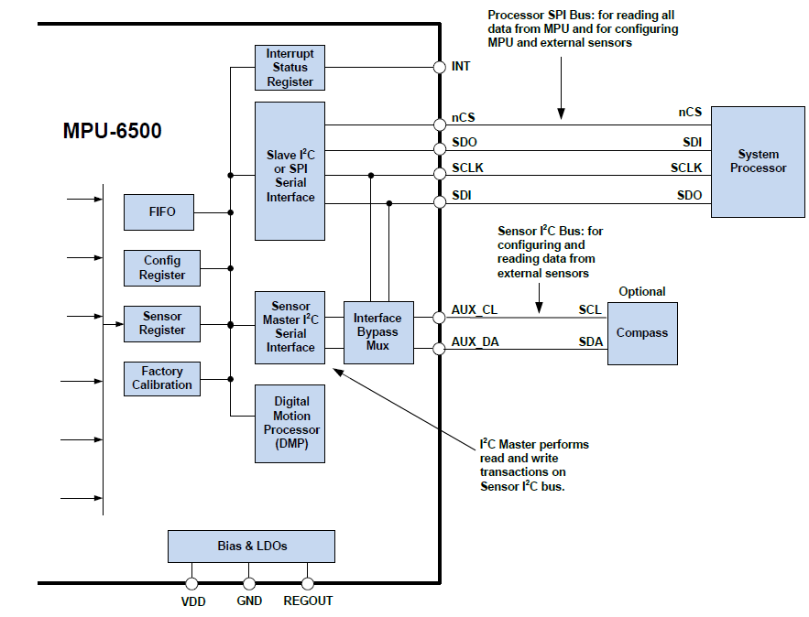
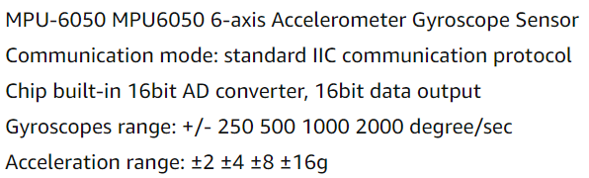
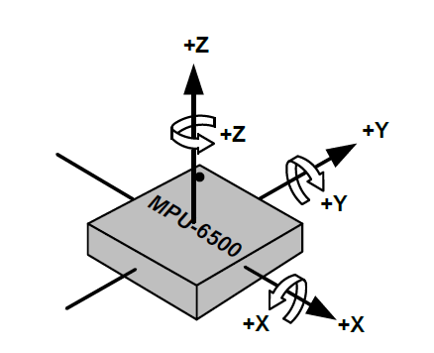
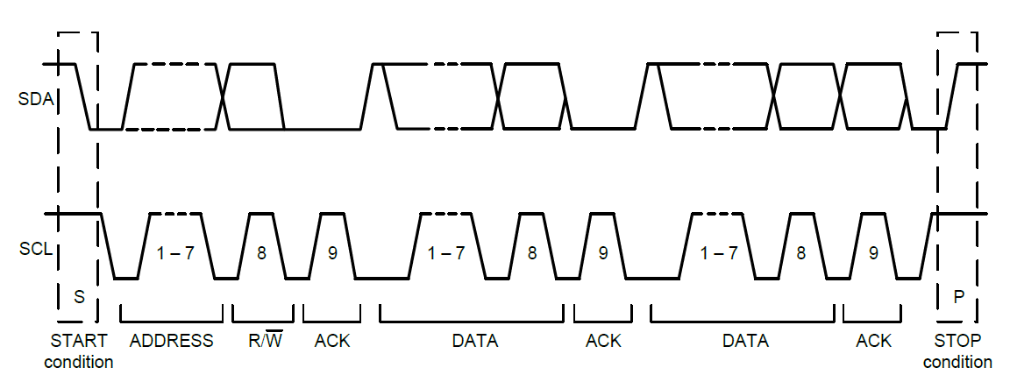
Where to start

Slide 10
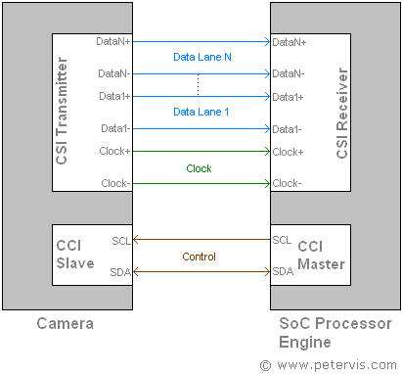
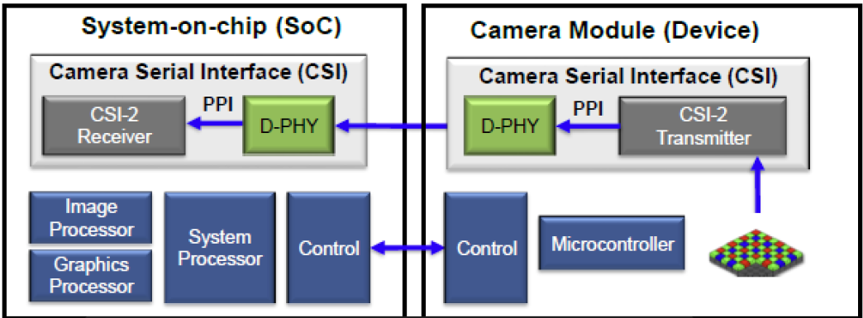
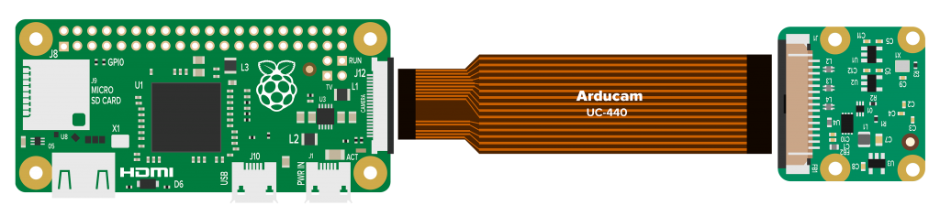
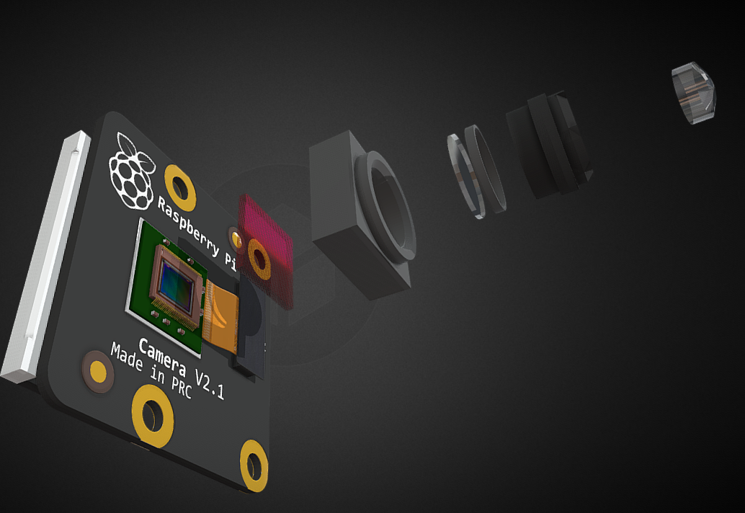
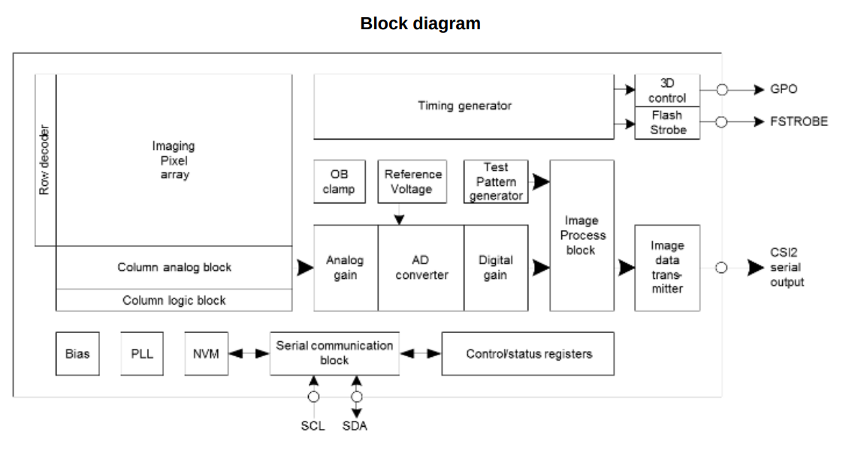
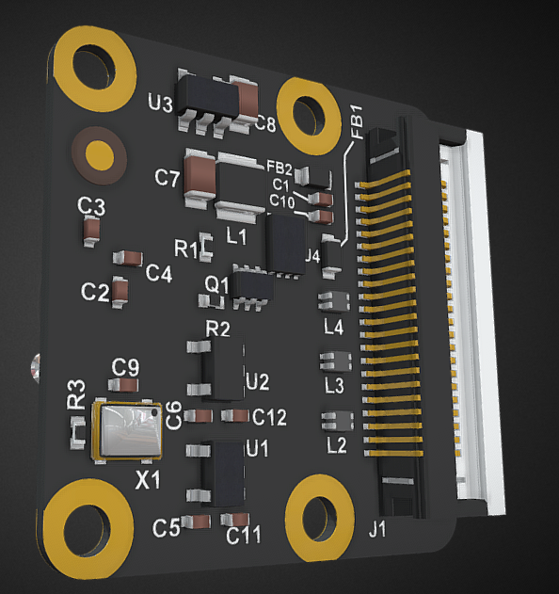
Read and analyze data
Camera Serial Interface (CSI)

Slide 11
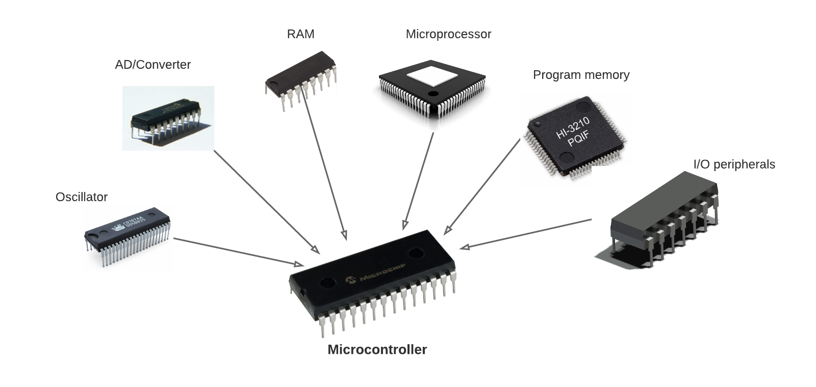
What are Microcontrollers
Generally, it has following components
Microprocessor : This the brain. This does all the processing.
RAM: This is the short-term memory, it holds the data for immediate use.
Program memory: This is long term memory, like runtime programs.
AD Converter, usually this is how you capture what happening around you. Most of the things happening around you changes it’s state slowly and continuously. The AD Converter converts information Into a format that computers understand.
I/O Peripherals: This is how you interact with the outside world; you can control external electronics using these input and out puts
Oscillators: This gives rhythm to everything and keep things moving. Think about your heart.

Slide 12
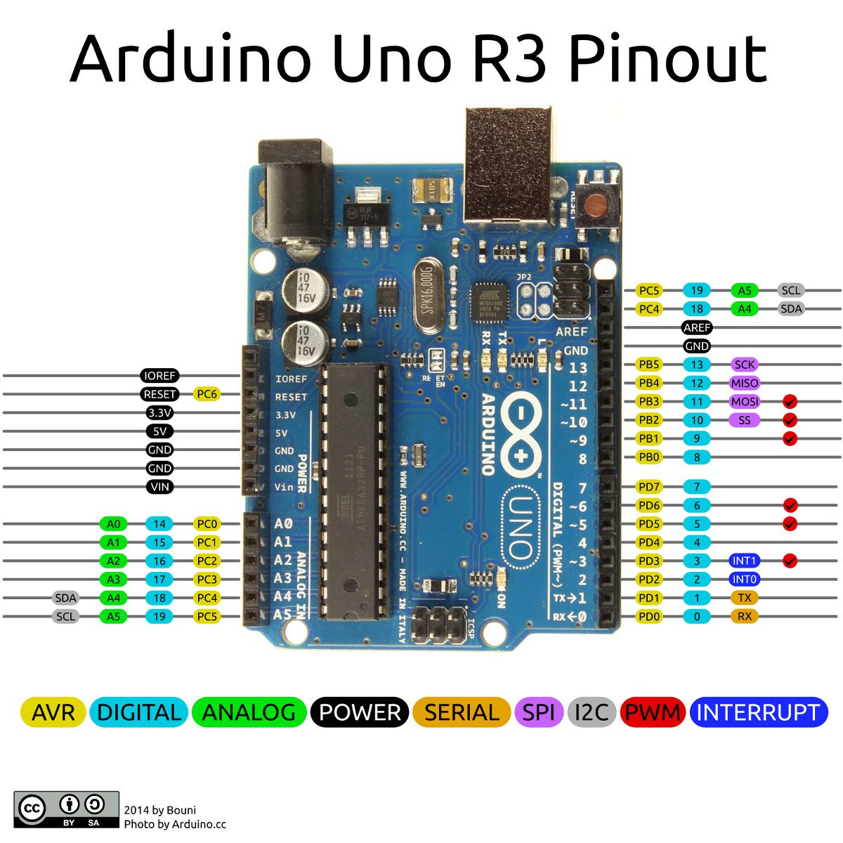
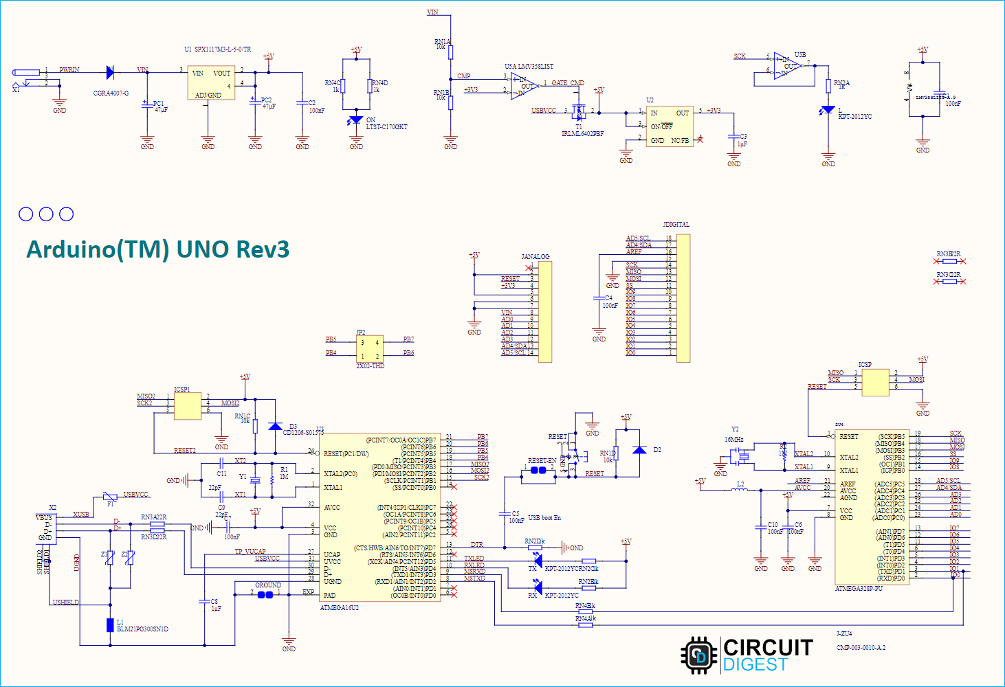
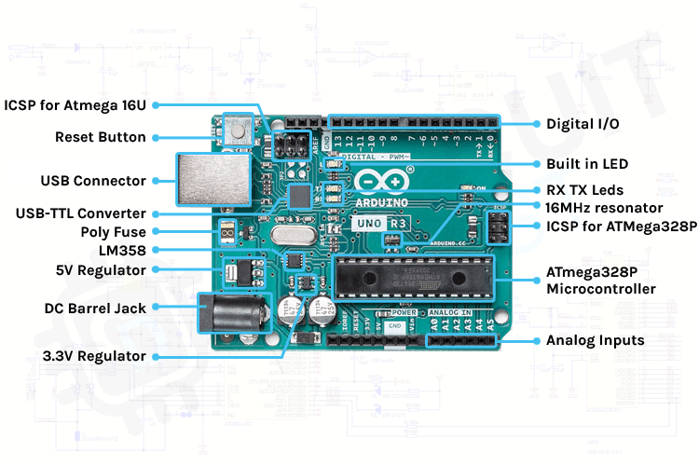
Why we use microcontrollers
Since everything is in the same chip, microcontrollers are fast and have low power requirements.
Relatively easy to configure and program.
Low cost.
Specialized for dedicated application , not suitable for general purpose application.
Very little supporting component needed.

Slide 13
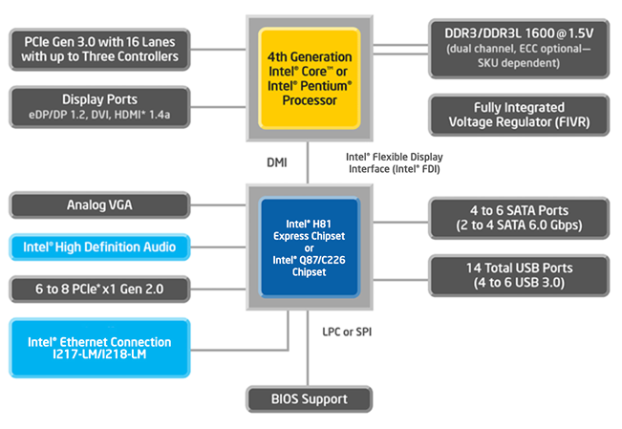
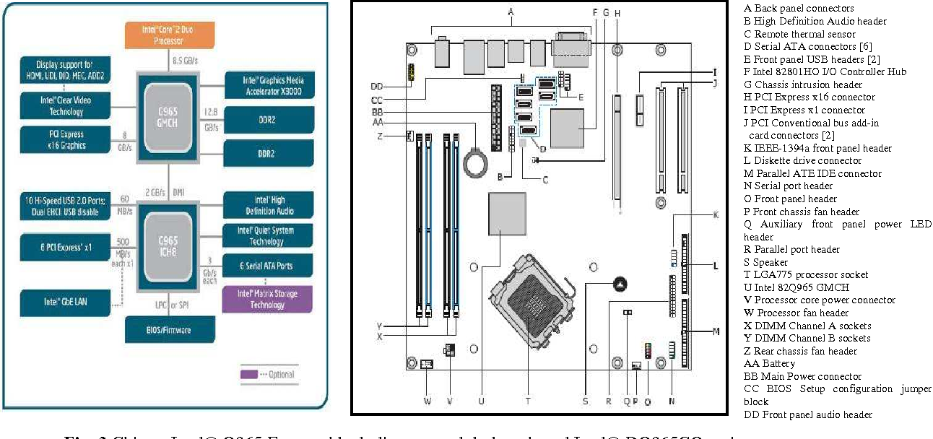
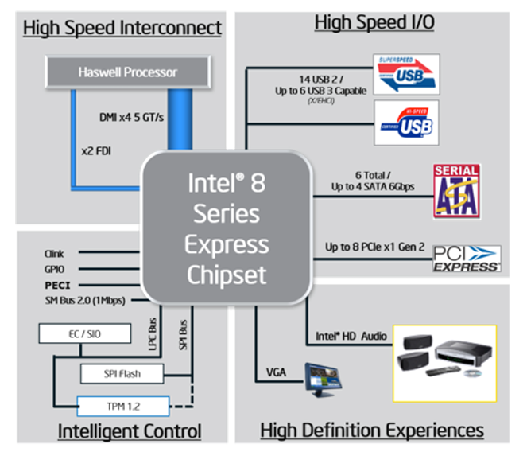
What if we need more resources or processing power?
That is where personal computers (PC) come in.
A PC has same components, but they are separate from each other.
Different components are connected by an interconnect, called bus
* Introduction to Intel® Architecture

Slide 14
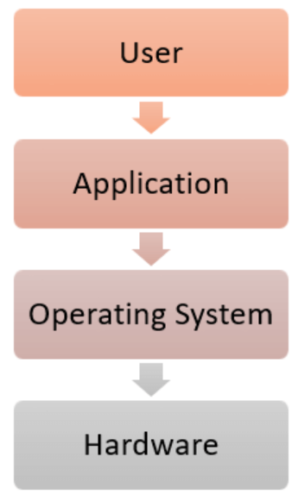
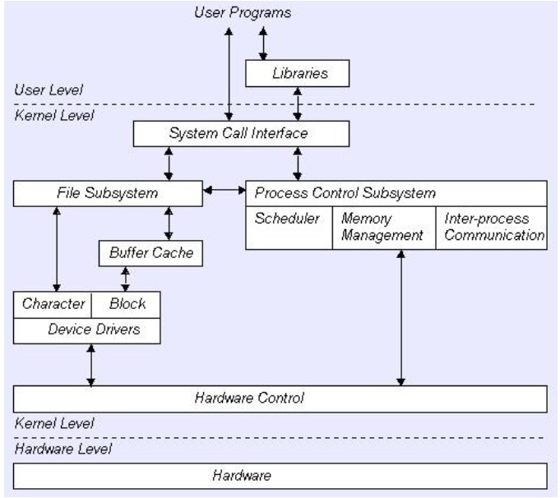
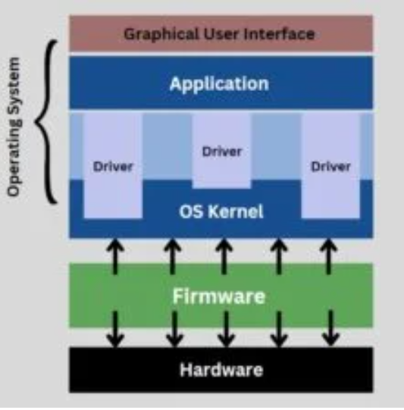
Operating system
Operating systems, such as Microsoft Windows, Mac OS, or Linux help organizing and communication between different components
Fine details about internal hardware are hidden from end user and OS provide beautiful abstraction

Slide 15
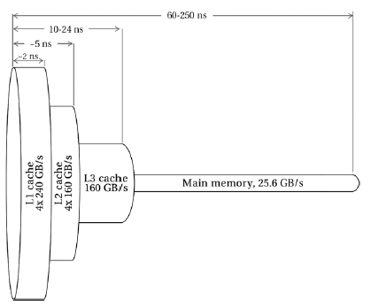
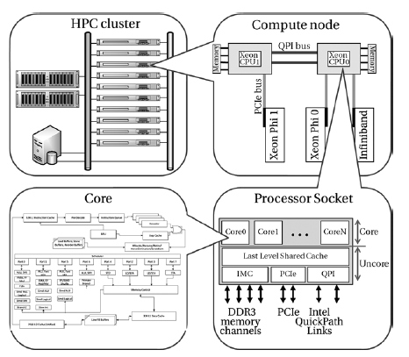
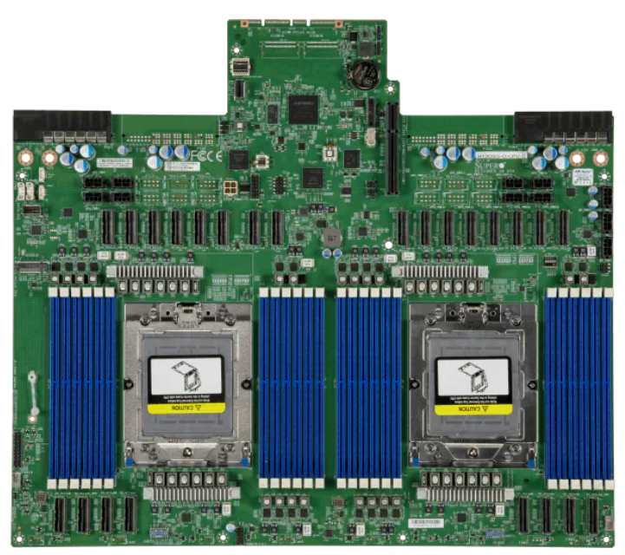
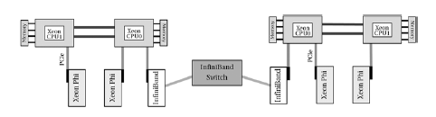
What if we need even more?
Then we need to use more than one computer and connect them and use them as one.

Slide 16
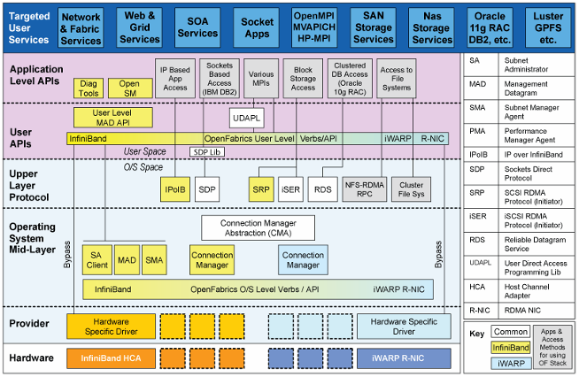
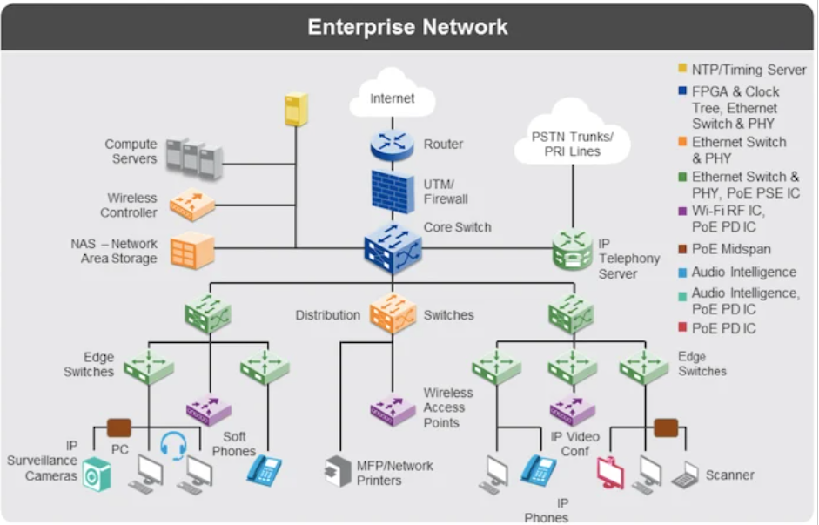
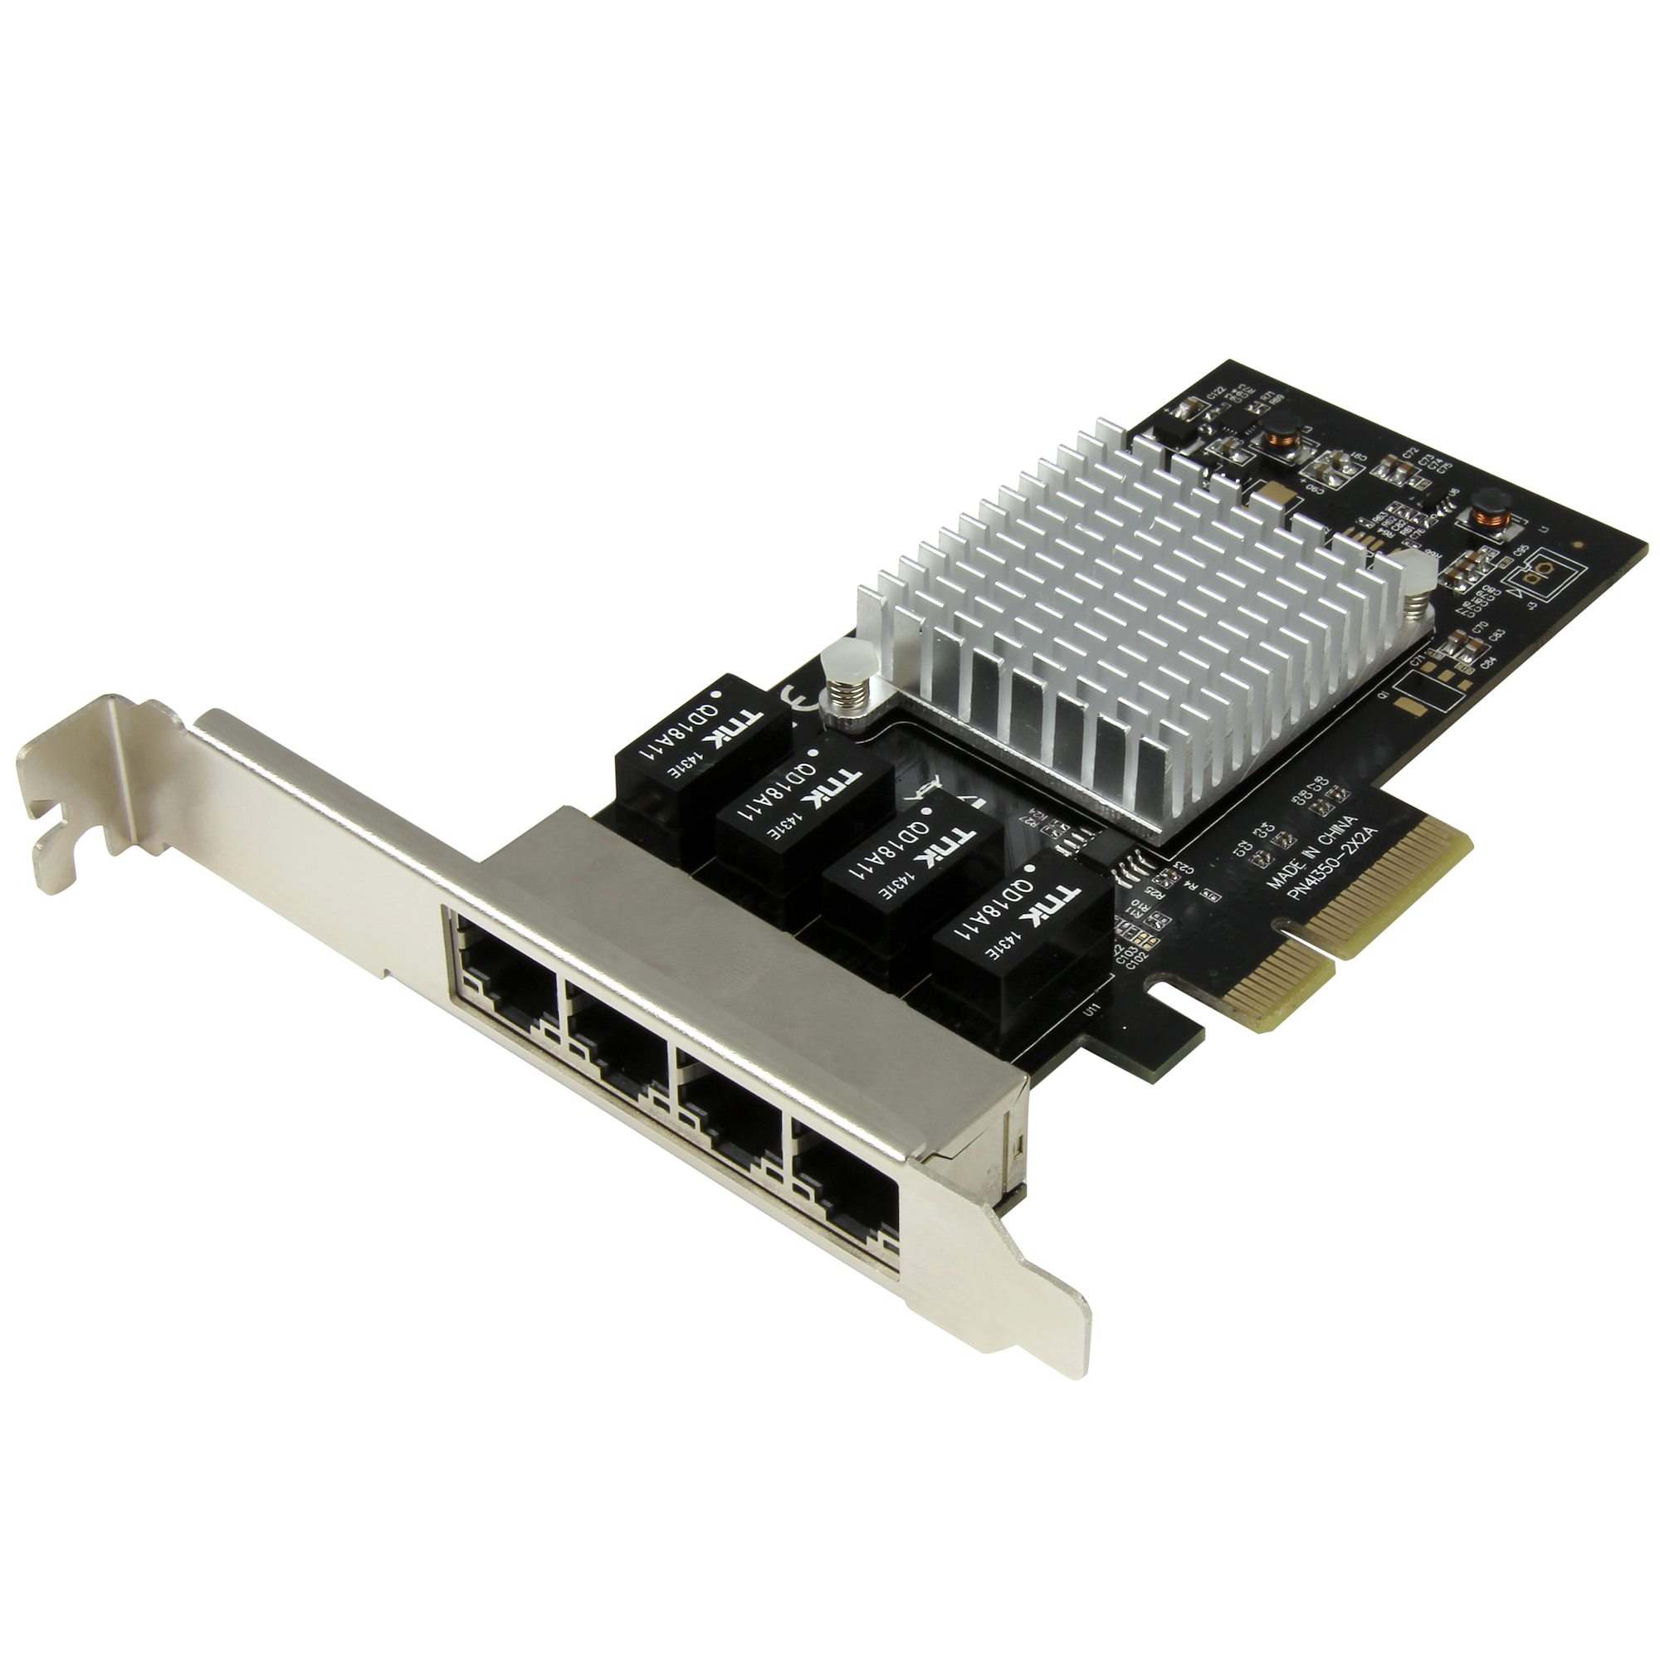
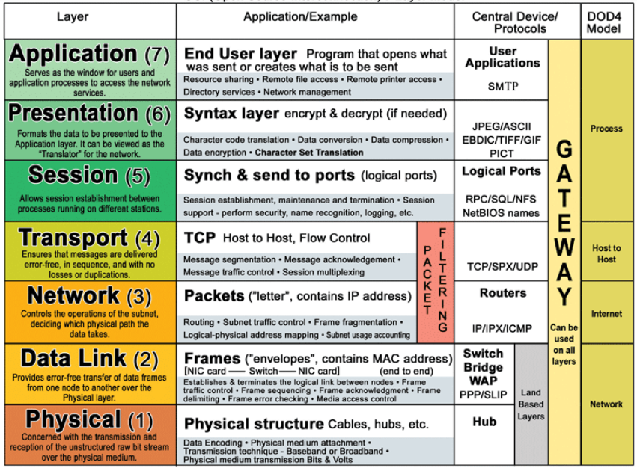
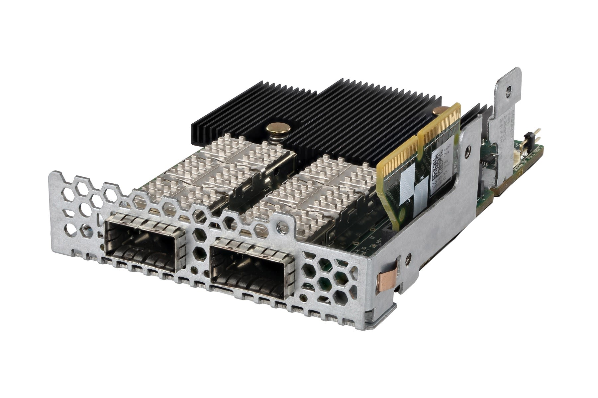
Need a way to communicate with each other
Need a common language and medium for the communication

Slide 17
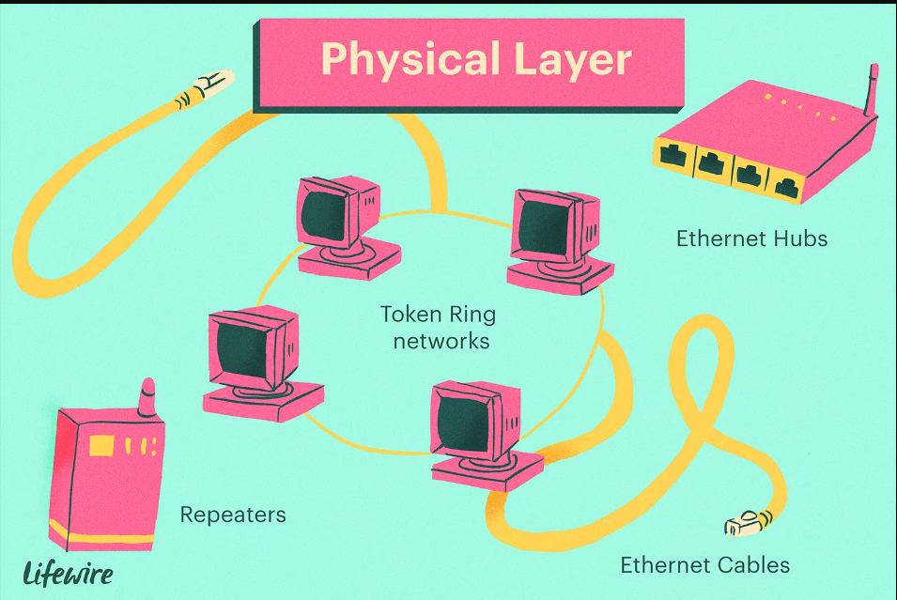
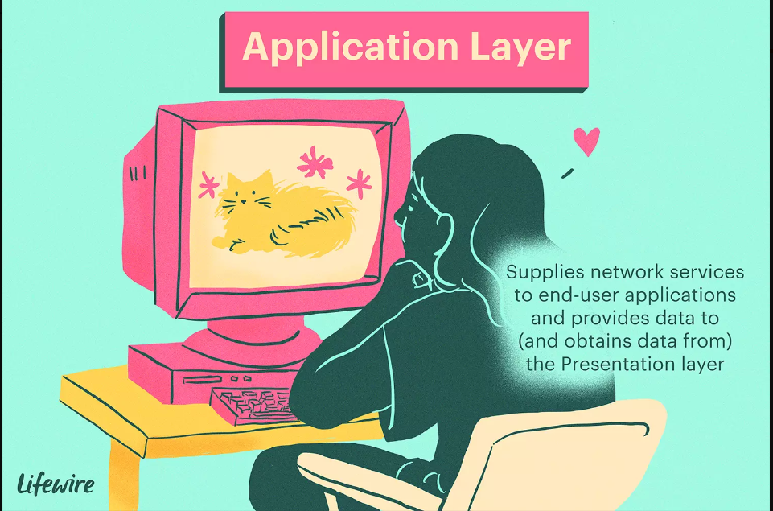






Slide 18





Communication protocols
I2C
SPI

Slide 19





UART (Universal Asynchronous Receiver/Transmitter)

Slide 20




Web communication protocols
HTTP
MQTT
Hyper
Text
Transfer
Protocol
Message
Queue
Telemetry
Transport[

